Slide 1
Spoken Language Understanding using Pre-training technique
Project Guide: Prof. Suresh. R. Mestry
Members: Saad Ghojaria, Rahul Kotian, Yash Sawant

Slide 2
Abstract
We have proposed a pre-training methodology for end-to-end SLU models and used datasets to show that our pre-training techniques improve performance for SLU training sets.
The end-to-end SLU systems map speech directly to intent. For high accuracy, a large amount of training data is needed.
We will try to reduce the data requirements of end-to-end SLU model.
A new SLU dataset is introduced which improves performance both when the full dataset is used for training purposes and also when only a small subset is used.
We also make additions to the model where new phrases are learnt by the model which is not trained on the model during the training phase.

Slide 3
Introduction
Spoken Language Understanding (SLU) system
Meaning or intent of the spoken utterance.
Signal processing, pattern recognition, ML & AI.
Two main components of SLU
Automatic Speech Recognition (ASR) module.
Natural Language Understanding (NLU) module.
Possible optimizations in ASR & NLU
Reducing the word error rate (WER).

Slide 4
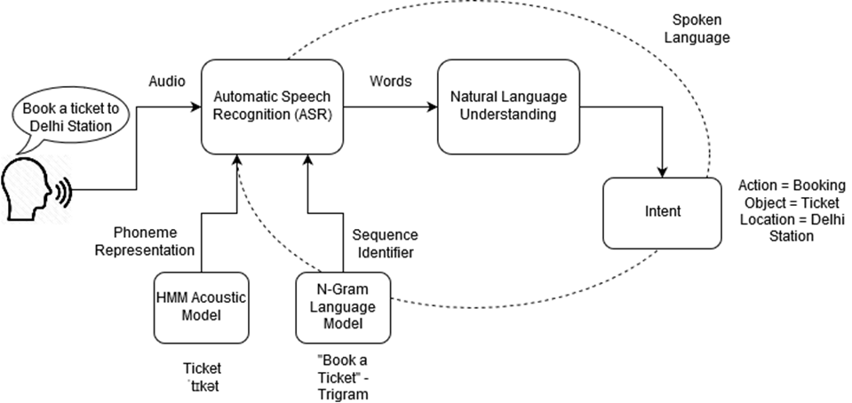
Basic Command System Architecture

Slide 5
Literature Review

Slide 6
Survey Of Existing System
Data requirement is more.
Time complexity is high.
Space complexity is high.

Slide 7
Literature Survey
TITLE | TECHNOLOGY | METHODS & ALGORITHMS | MATHEMATICS | CRITIC REVIEW
EXPLORING ASR-FREE END-TO-END MODELING TO IMPROVE SPOKEN LANGUAGE UNDERSTANDING IN A CLOUD-BASED DIALOG SYSTEM | Natural Language Understanding (NLU), End-to-end (E2E) modeling approach, Recurrent Neural Networks (RNNs), Feedforward neural networks. | Linear discriminant analysis (LDA), Maximum likelihood linear transform (MLLT), Semantic utterance classification, Pre-training, Word error rate (WER) | Vector mapping, Sampling, Maximum a posterior (MAP) estimation | Improve the performance of a sophisticated CNN-based SLU system with more accurate ASR hypotheses by fusing the scores from end-to-end (E2E) system.
TOWARDS END-TO-END SPOKEN LANGUAGE UNDERSTANDING | Natural Language Understanding, ASR | GRU,LSTM ALGORITHMS; Word error rate (WER) criterion | Chain Rule | When noisy data is encountered the efficiency of the system degrades, With significantly less parameters our system is able to reach 10% relatively worse accuracy

Slide 8
TITLE | TECHNOLOGY | METHODS & ALGORITHMS | MATHEMATICS
FROM AUDIO TO SEMANTICS: APPROACHES TO END-TO-END SPOKEN LANGUAGE UNDERSTANDING | Automatic speech recognition system (ASR) & Natural language understanding (NLP), Recurrent Neural network, Context-free grammar | Multiple ASR hypothesis, Word confusion network, Recognition lattice. Encoder-decoder based sequence-to-sequence (Seq2Seq) approach, Multitask learning, Minimum Bayes risk (MBR), Long-Short Term Memory (LSTM) cells, Word error rate (WER) | Sets for input & output sequence, structured data, deterministic scheme, conditional probability P(B|A;θ) using chain rule
SPOKEN LANGUAGE UNDERSTANDING WITHOUT SPEECH RECOGNITION | Intent Determination (NLU) | SVM ALGORITHM; Fine tuning, Direct training from audio to intent, Viterbi decoding | Conditional Probability
CAPSULE NETWORKS FOR LOW RESOURCE SPOKEN LANGUAGE UNDERSTANDING | Feedforward neural networks, Spoken Language Understanding, Capsule Networks, Deep Learning, Automatic Speech Recognition (ASR). | Iterative dynamic routing ALGORITHM; Hidden Markov Model (HMM), Cross-validation | Vector mapping, Distributive property, Linear transformation, Probability

Slide 9
Limitation Existing system or research gap
Requires a lot of pre-training on audio inputs before achieving peak performance.
Word-Error Rate is comparatively low but can be reduced further.
Needs a better noise removal algorithm.
It takes small dataset to work efficiently.

Slide 10
End-to-End SLU V/S Conventional SLU system
End-to-End SLU system maps :-
Speech directly to → intent
The model is first pre-trained to predict words and phonemes-improves performance
Conventional SLU system maps :-
Speech → text → intent,
No pre-training is done hence results are slow.

Slide 11
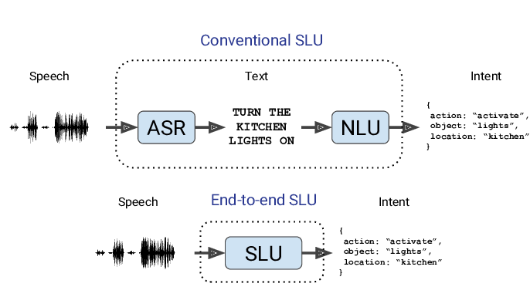
Conventional SLU vs End-to-End SLU
Notes:
https://usabilitygeek.com/automatic-speech-recognition-asr-software-an-introduction/

Slide 12
Problem Statement & Objective
In ASR the words which have similar sounding can be difficult for the machine to understand so incorrect input may be detected.
If for new words; the dataset is not trained then the classification cannot be done efficiently and the intent won’t be correct.

Slide 13
Scope
1. With significant improvements in the processing time, the end-to-end approach can be implemented for real-time applications like voice-activated personal assistants.
2. With every input fed to the machine, the machine is able to learn and then predict the words from the pre-trained set
3. As the pre-trained set will contain the most commonly used words, the processing & predicting time along with data requirement is reduced by a lot. This will benefit the IoT based home automation devices.
4. The future scope would be to recognize live speech, which would require more resources including larger speech databases, acoustic models and exhaustive vocabularies to produce good recognition results.

Slide 14
Proposed System
We are proposing end to end speech recognition using SLU wherein the main focus is on the pre-training rather than recognition and increase the efficiency.

Slide 15
List Of Algorithms
Hidden Markov Model
It is a statistical representation of the phonemes to the pronunciation wherein a table is formed consisting of 3 columns , first being input word then its phoneme representation and lastly its pronounciation model.
Viterbi Algorithm
Its a type of HMM which is used for finding the most likely sequence of hidden states.

Slide 16
Software Requirements
Fluent Speech Commands Dataset (.wav audio files).
Python Distribution – Anaconda.
Python Packages - PyTorch, numpy, soundfile, pandas, tqdm.

Slide 17
Methods and Algorithms

Slide 18
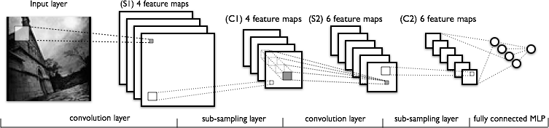
CNN
CNN - multi-layer NN architecture
Convolutional + Non-Linear Layer
Sub-sampling Layer
Convolutional +Non-L inear Layer
Fully connected layers
Supervised
Feature Extraction
Classi-
fication

Slide 19

Convolution + NL
Sub-sampling
Convolution + NL

Slide 20
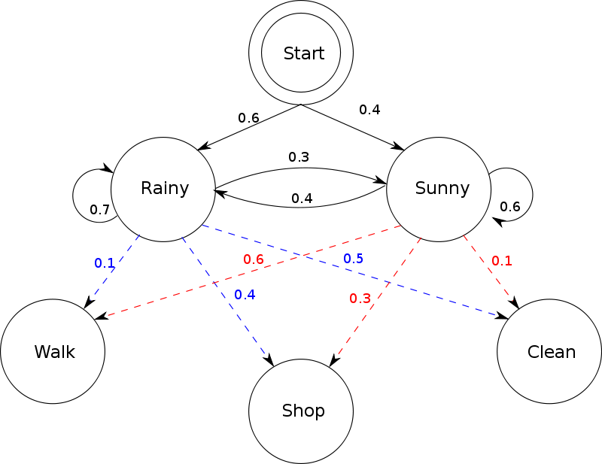
HMM
Hidden Markov Model (HMM) is a statistical Markov model in which the system being modeled is assumed to be a Markov process with unobserved (i.e. hidden) states.

Slide 21
RNN

Slide 22
N-gram

Slide 23
Viterbi

Slide 24
WER

Slide 25
References
[1] G. Tur and R. D. Mori, Spoken Language Understanding: Systems for Extracting Semantic Information from Speech. Wiley, 2011.
[2] G. Mesnil, Y. Dauphin, K. Yao, Y. Bengio, L. Deng, D. Hakkanitur, and X. He, “Using Recurrent Neural Networks for Slot Filling in Spoken Language Understanding,” IEEE/ACM Transactions on Audio, Speech, and Language Processing, 2015.
[3] A. Coucke, A. Caulier, A. Ball, C. L. Dec, and T. Bluche,“Snips Voice Platform: an embedded Spoken Language Understanding system for private-by-design voice interfaces,” arXiv:1805.10190v3, 2018.
[4] A. L. Gorin, G. Riccardi, and J. H. Wright, “How may I help you?” Speech Communication, vol. 23, no. 1-2, pp. 113–127,1997.
[5] Y. Qian, R. Ubale, V. Ramanarayanan, and P. Lange, “Exploring ASR-free end-to-end modeling to improve spoken language understanding in a cloud-based dialog system,” ASRU, 2017.

Slide 26
Thank You !!

